Slide 1
Why use ferrules and how to apply them correctly…
Maria Schierscher, Associate Product Marketing Manager – Industrial Tools

Slide 2
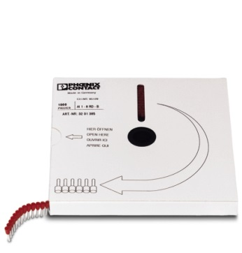
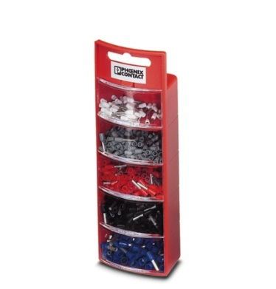
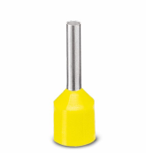
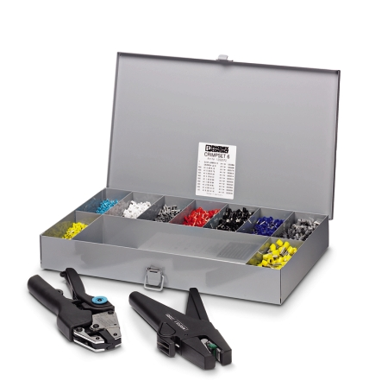
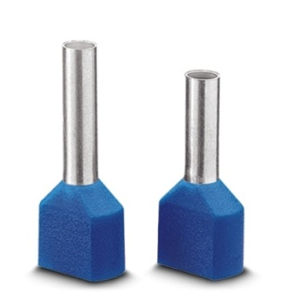
What is a ferrule?
Why you should use ferrules….
Copper tube that is tin plated with a nylon insulation
Sizes: 250MCM to 28 AWG
Styles:
Single – for use with one wire
Twin – for use with two wires
Strips – for use with specific hand tools
Reeled – for use with semi-automatic devices
Reeled ferrules for the CF3000
Ferrule kits
Twin (double) ferrules

Slide 3
Why are ferrules used?
Why you should use ferrules….
Solid Connection
strengthen stranded wire bundles
elimination of stray strands
Ease of installation
Long term electrical performance
Airtight
Corrosion resistance
Durability and safety of the connection
vibration resistance
avoidance of higher temperatures, short-circuits, and arc flashes
shape and integrity retention with removal and reinsertion
Twin ferrules allow simultaneous insertion of two wires
Required in Europe for CE certification
High quality, carefully designed and built panel

Slide 4
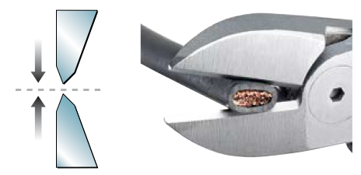
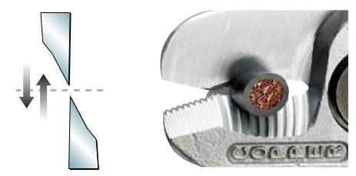
Cutting the wire correctly matters
Why you should use ferrules….
Be sure to not damage the wire when cutting.
Incorrect cut: Bite cut, squeezing the wire
Correct cut: Shear cut

Slide 5
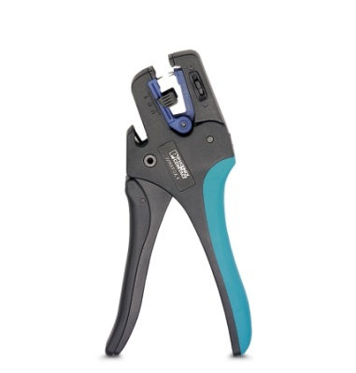
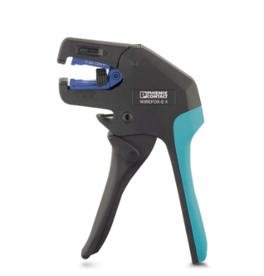
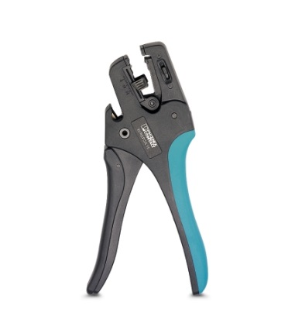
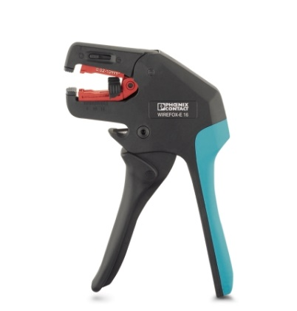
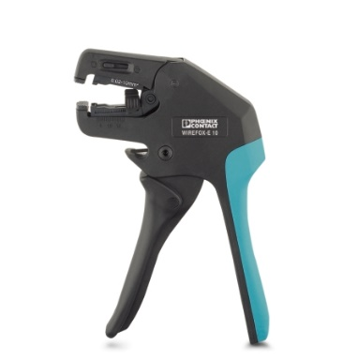
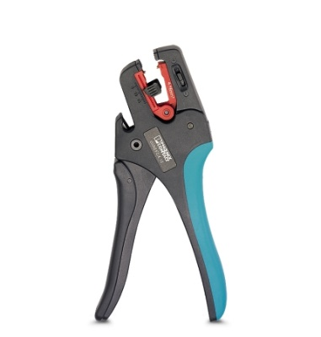
Choosing the correct wire stripping tool matters
Why you should use ferrules….
V-blade
Flat blade
Oval blade
WIREFOX – 4 1212159
WIREFOX-E 4 1212704
28-12 AWG
WIREFOX – 6SC 1212158
WIREFOX-E 6SC 1212705
16-8 AWG
WIREFOX – 10 1212150
WIREFOX-E 10 1212706
34-8 AWG
WIREFOX – 16 1212155
WIREFOX-E 16 1212707
12-5 AWG

Slide 6
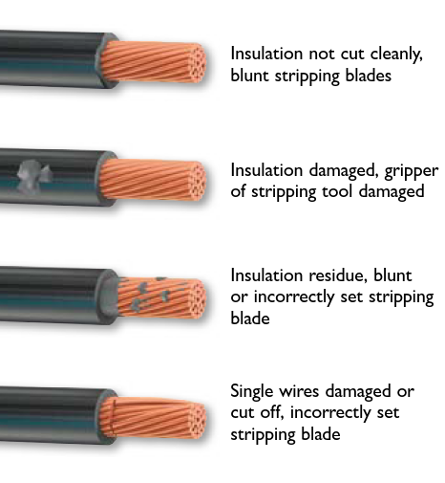
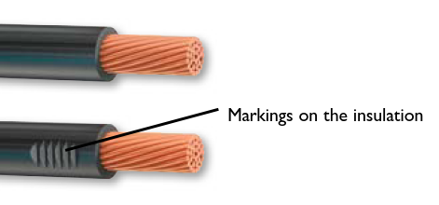
Stripping the wire correctly matters
Why you should use ferrules….
Be sure to not damage the strands or insulation when stripping the wire.
Incorrect strip:
Correct strip:

Slide 7
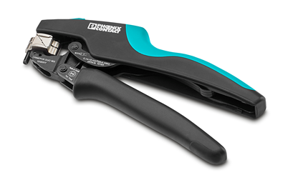
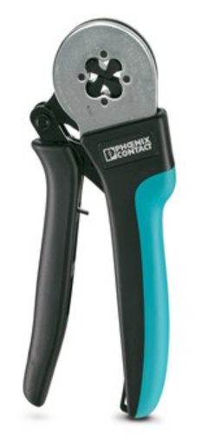
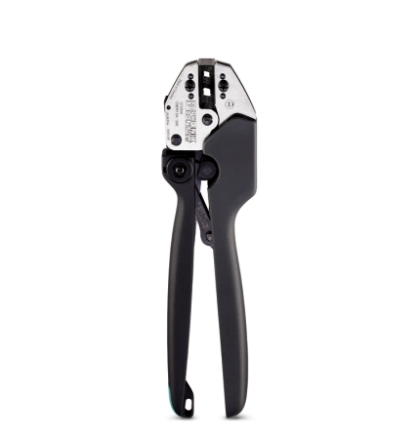
Choosing the correct crimping tool matters
Why you should use ferrules….
Ferrule crimpers vary by
AWG range
Crimp profile
Open or nested
Front or side entry
Length of the handle
CRIMPFOX DUO 16S 1202877 26-6 AWG single
2 x 20-10 twin
CRIMPFOX CENTRUS
6H NC 1202883 24-10 AWG
6S NC 1202882 24-10 AWG
10H 1213156 24-8 AWG
10S 1213154 24-8 AWG
CRIMPFOX 25R 1212039 8-4 AWG
CRIMPFOX 50R 1212041 2-1 AWG

Slide 8
Crimp Profiles…Which one should I use?
Why you should use ferrules….
WM Crimp
Hex Crimp
Square Crimp
Indent/prong Crimp
Double indent Crimp
Oval Crimp
Trapezoid Crimp
B Crimp
Crimp profiles are based on user and application preference
Conductor must be prepared correctly
Contact and conductor must be compatible
Conductor must be positioned correctly in the contact
Suitable crimping tool must be used

Slide 9
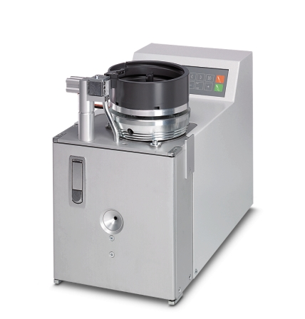
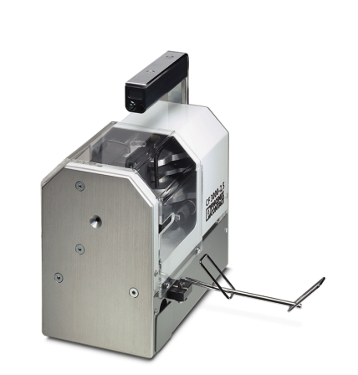
Or automate the crimping
Why you should use ferrules….
CF 1000-1,5 1208199 22-12 AWG
20-16 AWG dies included
CF 1000-10 1212456 12, 10, 8 AWG
No dies included
CF 3000 1205516
20-14 AWG dies included
22 AWG kit 1212376

Slide 10
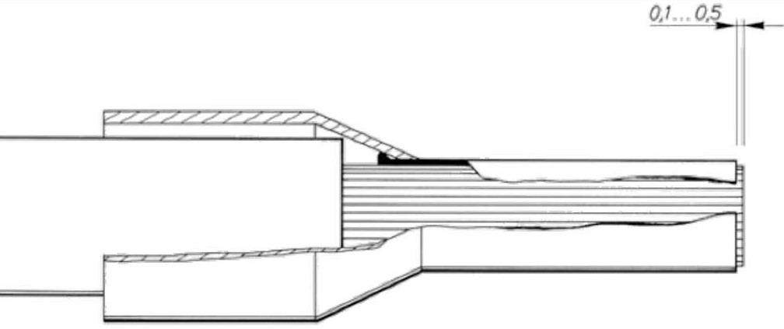
How to apply a ferrule
Why you should use ferrules….
Flush cut the conductor
Using a suitable wire stripper, strip the insulation off the conductor
Insert the stripped conductor into the plastic collar
The strands should completely fill the ferrule’s barrel and protrude no more than .02” (0.5mm)

