Slide 1
TOOL fox: The right tool for every application

Slide 2
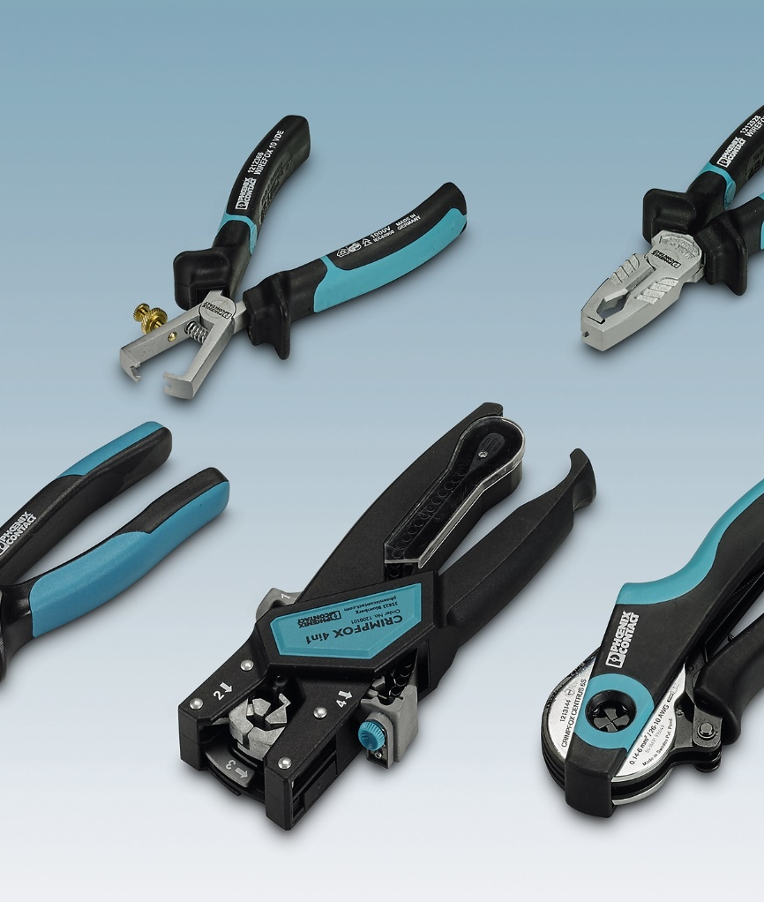
Agenda
TOOL fox: The right tool for every application
Hand Tools
  CUTFOX cutting tools
  UNIFOX universal cutters & pliers
  WIREFOX stripping tools
  CRIMPFOX crimping tools
  SCREWFOX screwdrivers
  MICROFOX electronic cutters & pliers
Tool & Crimp Sets
Semi-Automatics

Slide 3
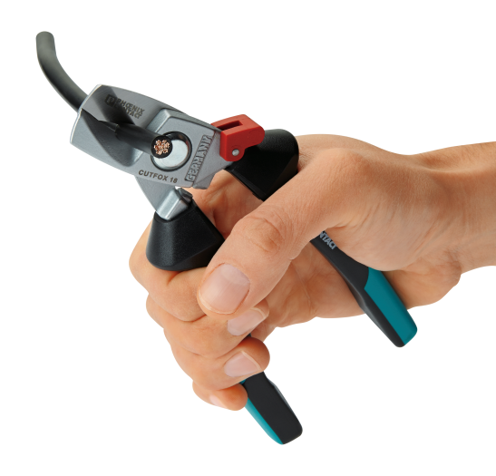
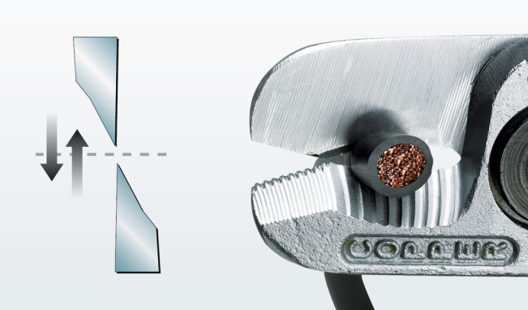
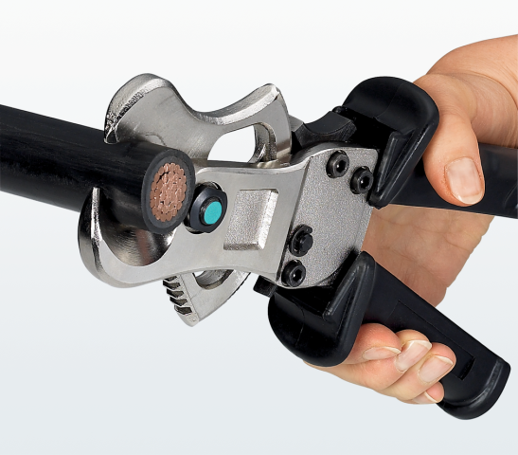
CUTFOX Cutting Tools
Hand Tools
Clean cutting without squeezing the cable
Ergonomic
Special cutting edge geometry
Special hardened steel
Non-slip handles
Styles
  Electrician’s scissors
  Front cable cutters
  Ring Cable cutters
  VDE front and diagonal cutters
  Special cutting tool

Slide 4
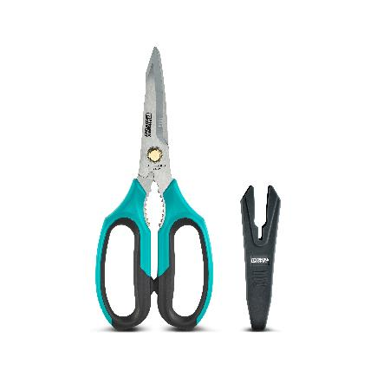
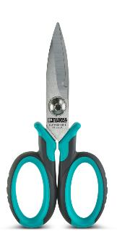
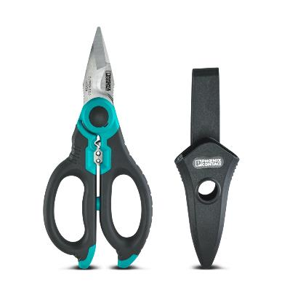
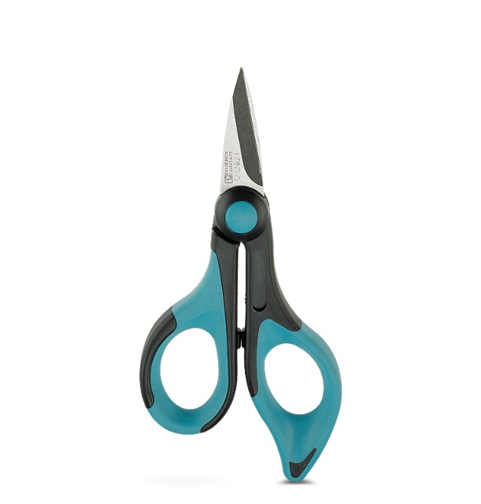
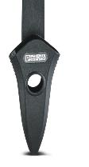
CUTFOX Electrician’s Scissors
Hand Tools
CUTFOX – ES
1212621
Cutting: copper, aluminum, Kevlar fibers, and plastic
CUTFOX – ES-1
1139721
Cutting: < 10 mm² Dismantling: < 35 mm²
CUTFOX – ES-2
1139724
Cutting: < 50 mm² Dismantling: < 50 mm² Stripping: 1.5 mm²/ 2.5 mm² Crimping: 6 mm² RC…
CUTFOX – MPS
1139725
Cutting: sheets, plastics, cards …and the back blades for cartons

Slide 5
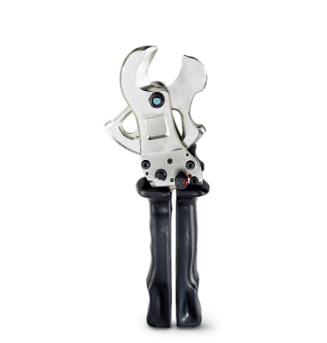
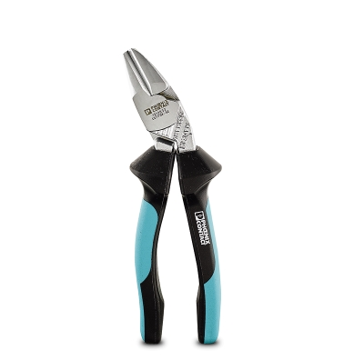
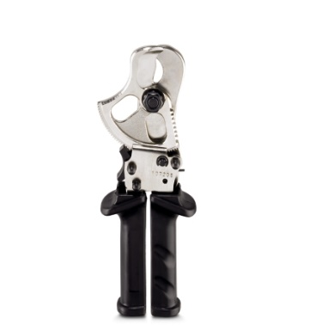
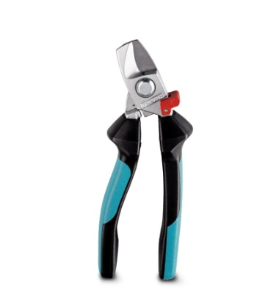
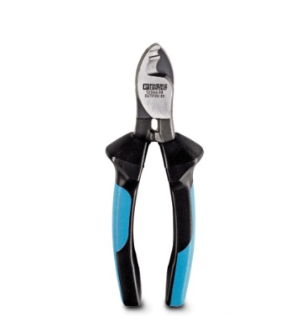
CUTFOX Front Cable Cutters
Hand Tools
CUTFOX – 12
1212128
Up to 12 mm
CUTFOX – 18
1212129
Up to 18 mm
CUTFOX – SE
1212832
Up to 180 mm
CUTFOX – 25
1212130
Up to 25 mm
CUTFOX – 35
1212131
Up to 35

Slide 6
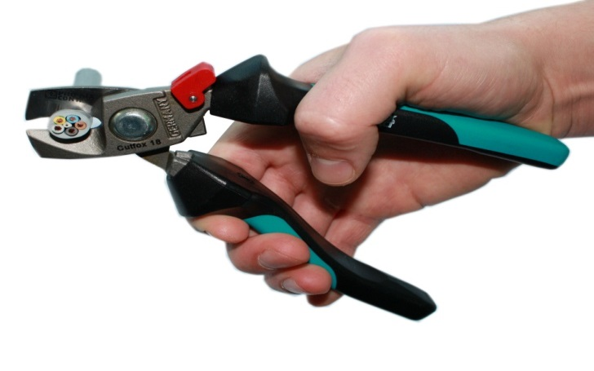
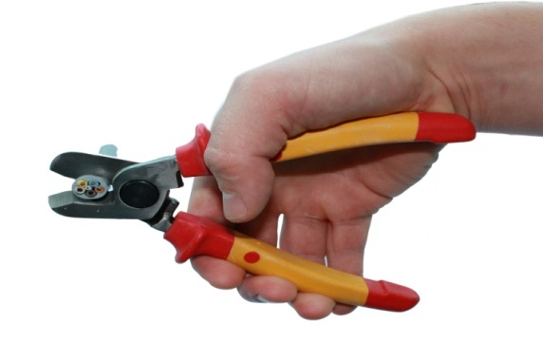
CUTFOX 18 Features and Benefits
Hand Tools
NEW
Spring loaded
Locking mechanism
Ergonomic design
Angled head for straight wrist positioning
For copper and aluminum cable up to 1/0
OLD

Slide 7
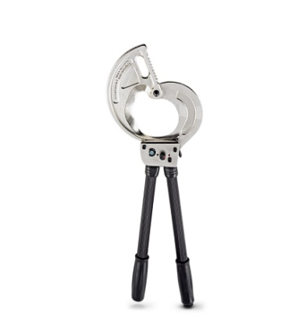
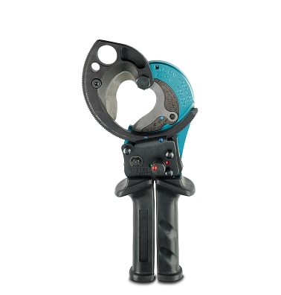
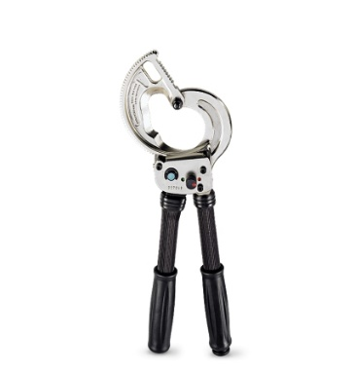
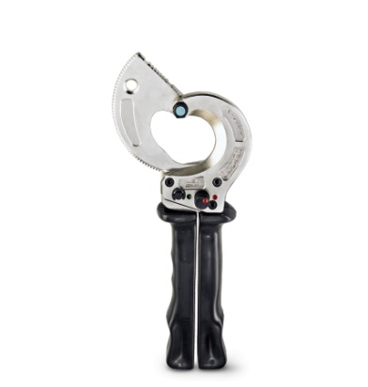
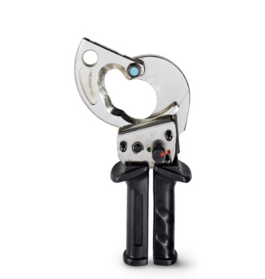
CUTFOX Ring Cable Cutters
Hand Tools
CUTFOX – 45
1212132
Up to 45 mm (1.77”)
CUTFOX – 52
1212133
Up to 52 mm (2.05”)
CUTFOX – 62
1212134
Up to 62 mm (2.44”)
CUTFOX – 100
1212135
Up to 100 mm (3.94”)
CUTFOX 50 STEEL
1212526
Up to 50 mm (3.94”)

Slide 8
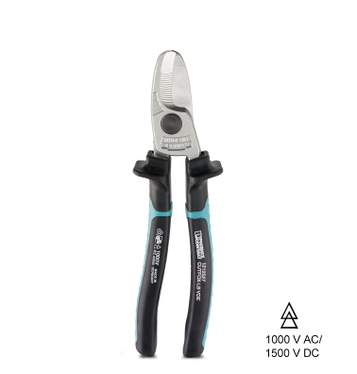
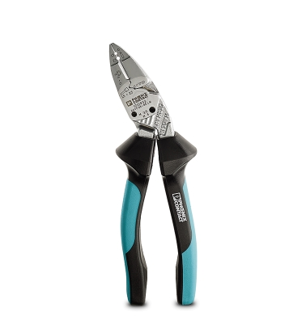
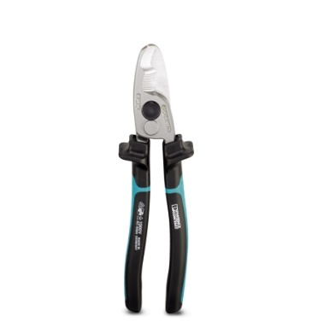
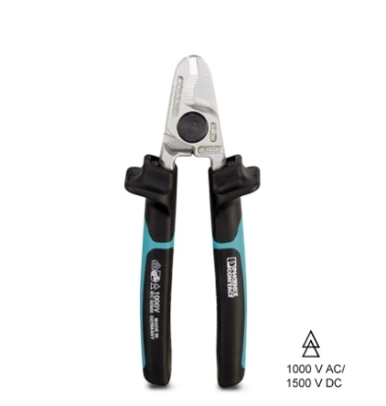
CUTFOX Front VDE Cable Cutters
Hand Tools
CUTFOX –16 VDE
1212126
Up to 16 mm
CUTFOX – 25 VDE
1212127
Up to 25 mm
CUTFOX – LB VDE
1212527
Up to 50 mm
CUTFOX – SE VDE
1212833
Up to 180 mm

Slide 9
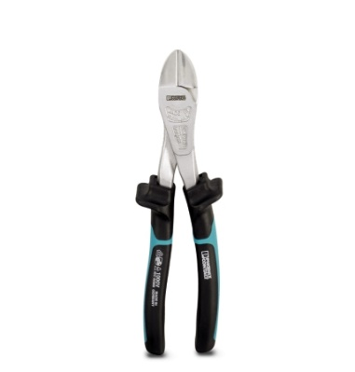
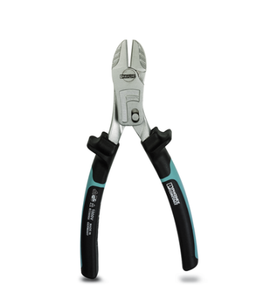
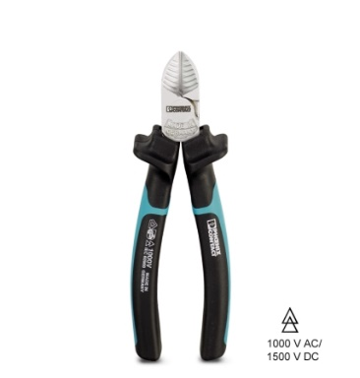
CUTFOX Diagonal VDE Cable Cutters
Hand Tools
CUTFOX – S VDE
1212207
VDE 1000 V AC/1500 V DC tested
CUTFOX – SP
BOLT VDE
1212831
Diagonal cutter, 200 mm, induction-hardened cutting
CUTFOX – SP VDE
1212206
Power diagonal cutter, with optimized leverage

Slide 10
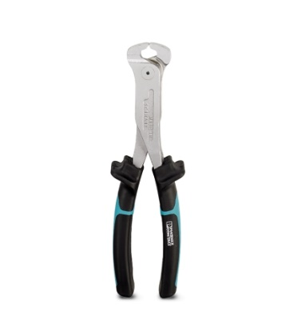
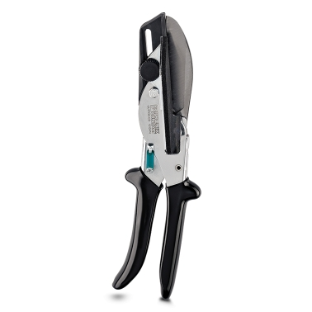
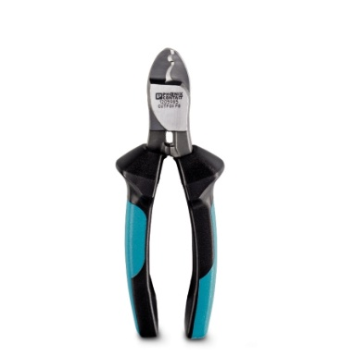
CUTFOX Special Purpose Cutting Tools
Hand Tools
CUTFOX – FBS
1212124
For separating individual jumper bars from fixed bridges
CUTFOX – FB
1205985
One-hand bridge cutter for fixed bridges
CUTFOX – CD
1212474
Wire duct cutters up to 75mm
Right angled and bevel cuts

Slide 11
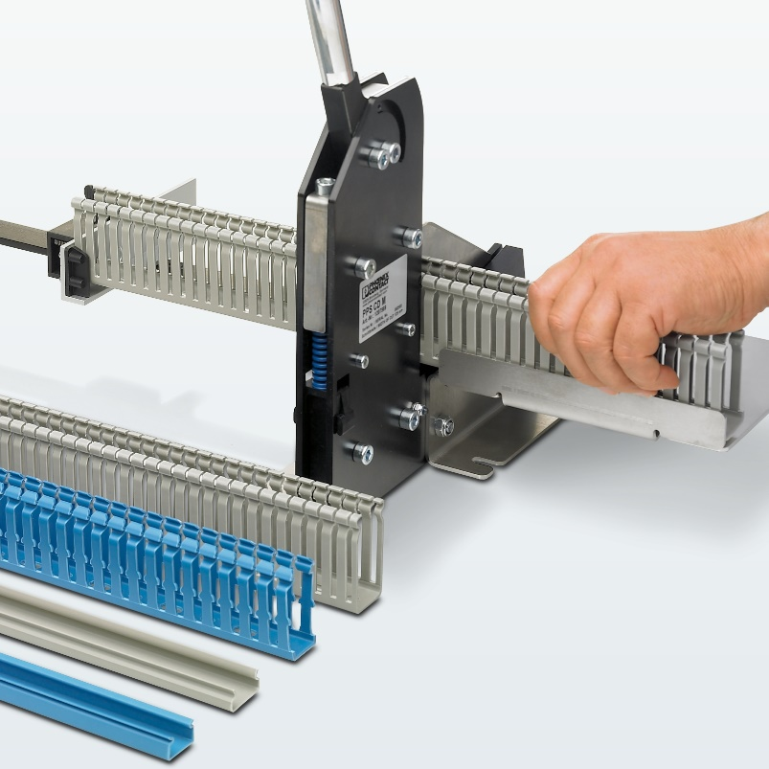
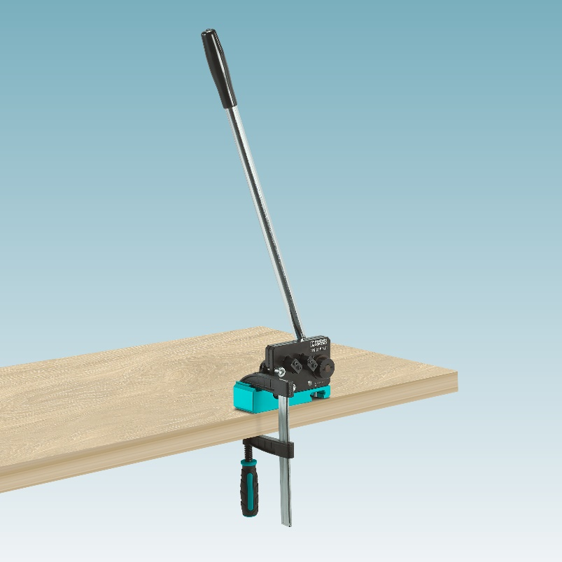
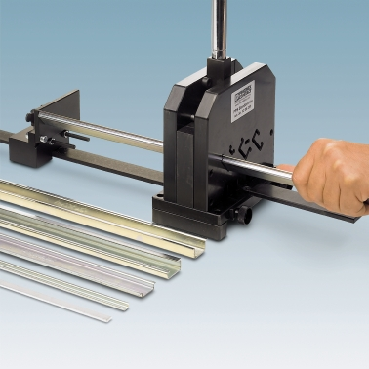
CUTFOX Bench Top Wire Duct and DIN Rail Cutters
Hand Tools
PPS CD M 1207569
Wire Duct Cutter for up to 125 mm wide and 2.5 mm thick
PPS COMPACT 1104980
Portable DIN rail cutter for standard NS 35/7,5 and NS 35/15
(clamp and scale sold separate)
PPS BASIC I/M 1207585
Benchtop mounted DIN rail cutter for standard NS 15, 35/7,5, NS 35/15 and CLS-CU 3/10 Busbars

Slide 12

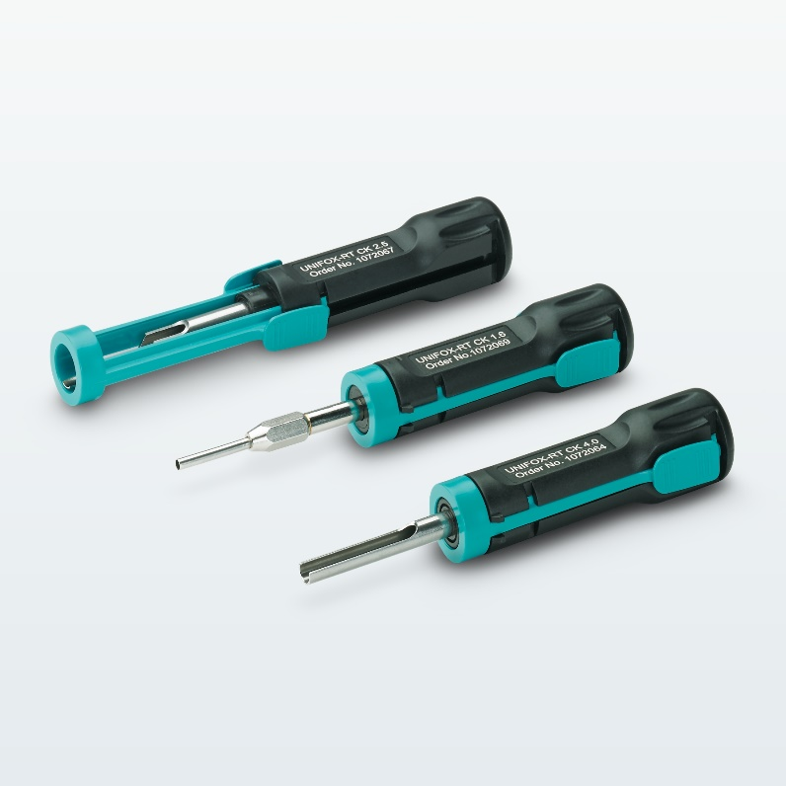

UNIFOX Contact Removal and Assembly and Rivet setting Tools
Hand Tools
UNIFOX RT-CK 1.6 1072069
UNIFOX RT-CK 2.5 1072067
UNIFOX RT-CK 4.0 1072064
UNIFOX MT-CK 1.6/2.5 01089092
Removal tools for turned contacts and assembly tool for crimp contacts
UNIFOX-RVT PA 4 1212478
Unifox-RVT PA 6 1212509
For processing plastic shield rivets

Slide 13
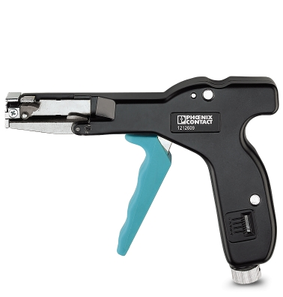
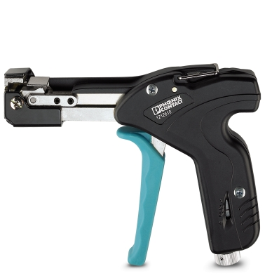
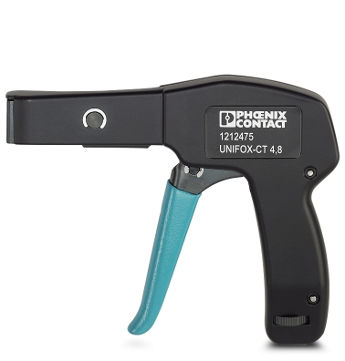
UNIFOX Wire Tie Tools
Hand Tools
UNIFOX-CT 4,8
1212475
For plastic wire ties up to 4.8 mm wide
UNIFOX-CT 4,8P
1212609
For plastic wire ties up to 4.8 mm wide
UNIFOX-CT M 7,9
1212610
For stainless steel wire ties up to 7.9 mm wide

Slide 14
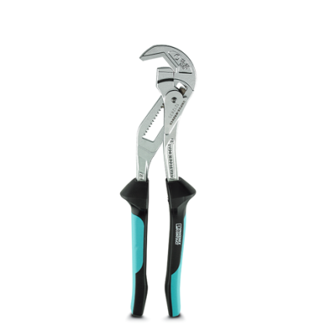
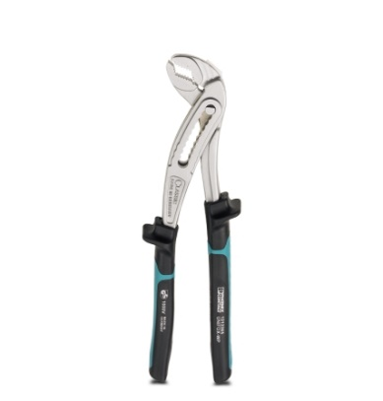
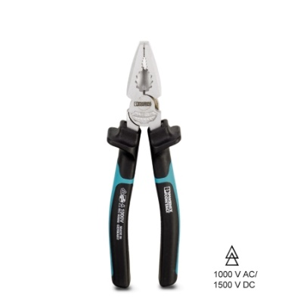
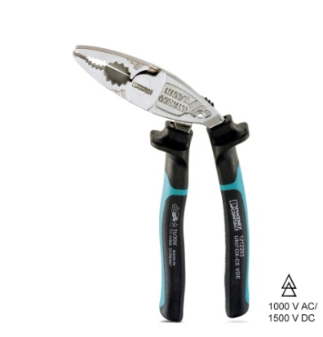
UNIFOX VDE Combination Pliers and Pipe Wrenches
Hand Tools
UNIFOX – C VDE
1212202
Combination pliers, cross-notched grip area
UNIFOX – CE VDE
1212203
Cross-notched grip area, integrated M8 - M10 ring wrench
UNIFOX – WP
1212365
Water pump pliers, with groove joint, grip areas with dual notching
UNIFOX – Wrench
1212835
Slip-joint wrench with fast adjustment

Slide 15
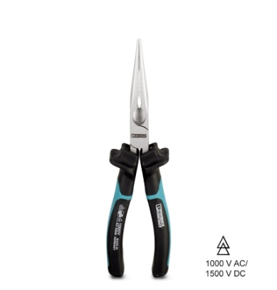
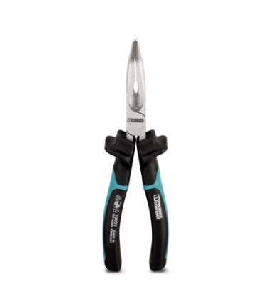
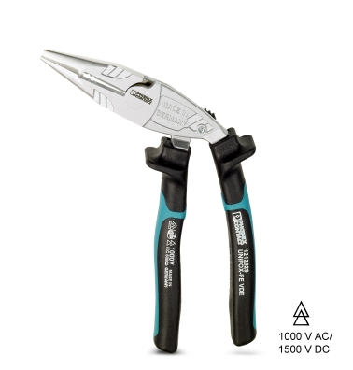
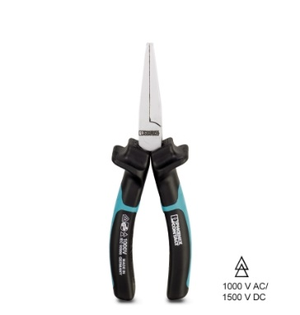
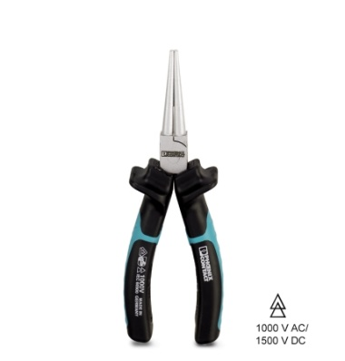
UNIFOX VDE Needle & Round Nose and Flat Pliers
Hand Tools
UNIFOX – P VDE
1212204
Needle-nose pliers with blade, notched grip area
UNIFOX – PC VDE
1212205
Needle-nose pliers with blade, angled 45°, notched grip area
UNIFOX – PE VDE
1212529
Needle-nose pliers with blade, angled design, opening spring and locking device. Wire stripping for 1.5 mm² and 2.5 mm², integrated M8-M10 ring wrench
UNIFOX – F VDE
1212363
Flat-nose pliers, finely notched gripping surface
UNIFOX – R VDE
1212364
Round-nose pliers, finely notched grip area

Slide 16
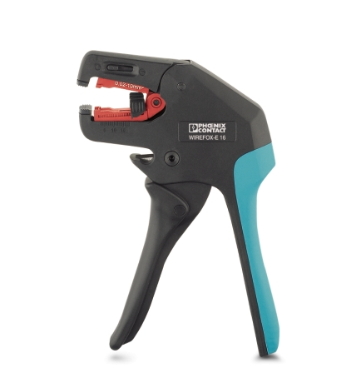
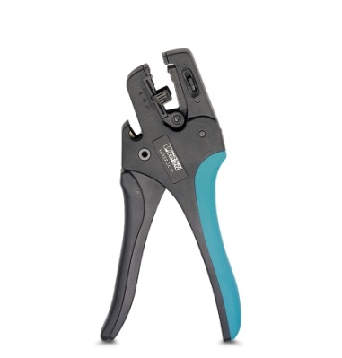
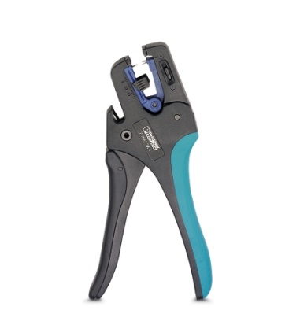



WIREFOX Wire Insulation Stripping Tools
Hand Tools
Flat blade
V-blade
Oval blade
28-12 AWG
WIREFOX – 4 1212159
WIREFOX-E 4 1212704
16-8 AWG
WIREFOX – 6SC 1212158
WIREFOX-E 6SC 1212705
16-8 AWG
WIREFOX – 16 1212155
WIREFOX-E 16 1212707
12-5 AWG
WIREFOX – 10 1212150
WIREFOX-E 10 1212706
34-8 AWG

Slide 17





WIREFOX Features and Benefits
Hand Tools
Stripping and dismantling
  of standard cables
  and conductors
Integrated cutter
Ergonomic design
Blades replaceable and interchangeable
Non-slip handles
Special blade geometry

Slide 18



WIREFOX Competitor Comparison
Hand Tools
The others….
VS.
Open die - accepts a range of AWG’s
Consistent strip length
Replaceable and interchangeable dies
Wide range of AWG’s
Integrated cutter
2-component handles
Insulation thickness and grip strength adjustable
Wide AWG range
Nested die – specific AWG in each groove
Inconsistent strip length
Minimal AWG range
Non-adjustable for insulation thickness or grip

Slide 19




WIREFOX Special Insulation Stripping Tools
Hand Tools
WIREFOX 16-1 1212157
WIREFOX SAC 1212623
WIREFOX SAC-1 1212757
Sensor/Actuator Cable stripper
WIREFOX – ASI
For AS-Interface Flat-ribbon Conductors
WIREFOX – D SHIELD
For Cable Cutouts and Shield Connections
WIREFOX – 10 VDE
For stripping conductors with a cross section of up to 10 mm²

Slide 20





WIREFOX Multiconductor and Large Diameter Insulation Stripping Tools
Hand Tools
WIREFOX - D 40
1212161
Stripping tool, for stripping installation lines of 4.5 – 40 mm
WIREFOX - D 13
1212162
Stripping tool, for stripping installation lines of Ø 8 - 13 mm
WIREFOX – D SR 6
1212507
WIREFOX – D SR 6-1
1212511
Stripping tool, for 2.5 - 6 mm² solar cables, 8.5 mm or 15 mm stripping length
WIREFOX – D 11
1212160
Stripping tool, for stripping multicore signal, control and fiberglass wires of Ø 2.5 - 11 mm
WIREFOX – D 16
1212173
Stripping tool, for stripping lines (specially for fiber optics lines) of Ø 4 - 16 mm

Slide 21
WIREFOX D40 Features and Benefits
Hand Tools
Interchangeable cable guide allows for large capacity (40mm/1.57”) diameter
Locking positions for circular, lengthways and spiral cuts
Easy to use
Ergonomic
Tough & Durable – twice the strength of standard nylon
Safe - no sharp exposed edges
Handle holds replacement blades

Slide 22





Crimpfox Features and Benefits
Hand Tools
>25% less effort & fatigue
Guaranteed crimp connections
High pull out force
Integrated forced-lock-system
Precision made interchangeable dies
2-component ergonomic handles for non-slip operation
Ferrules, turned contacts, coaxial connectors, FO connectors, D-Sub contacts, snap-in contacts, solar connectors
UL486F with Phoenix Contact ferrules

Slide 23


Crimpfox Centrus Features and Benefits
Hand Tools
Self-adjusting
Smaller ergonomic handles
Non-slip pressure pad
Ratcheted mechanism ensure proper crimp
Protective head cover and Balance weight
UL486F with Phoenix Contact ferrules
Available with square or hex crimp profiles
Crimpfox Centrus Set includes: Crimpfox Centrus, AI Sorti Box Rd, Cutfox 18, Wirefox 10, Tool-Kit Standard Empty

Slide 24

Crimpfox Duo 10 Features and Benefits
Hand Tools
Rotating crimping pliers for front or side entry
Accommodates 24 - 8 AWG single wires, or 2x20 - 2x12 AWG twin ferrules
Ergonomic handling
Self-adjusting for AWG
UL486F with Phoenix Contact ferrules
Trapezoidal crimp profile
Handles offer a non-slip pressure pad
Crimpfox Duo 10 Part #1031721
Crimpfox Duo 10 Set includes AI Sorti Box Rd, AI Sorti Box BU, AI Twinn Sorti Box BU, Tool-Kit Standard Empty
Like the crimper, but don’t want the rotating die? Try Crimpfox 10T-F #1134913 with side entry

Slide 25
Crimpfox 4in1 Features and Benefits
Hand Tools
20-14 AWG - 4 in 1 Combination tool
Cut, Strip, Twist and Crimp with one tool
4-stage pressure lock ensures high quality crimping
Quick and easy AWG ferrule magazine change
Ergonomic handling
Self-adjusting for AWG
UL486F with Phoenix Contact ferrules

Slide 26








Crimpfox Crimp Geometries
Hand Tools
Square-Crimp
O-Crimp
Double-Indent-Crimp
Indent-Crimp
WM-Crimp
Trapezoid-Crimp
B-Crimp
HEX-Crimp

Slide 27




Crimpfox: Why use ferrules?
Hand Tools
Twin (double) ferrules
Solid connection
Ease of installation
Long term electrical performance
Provides durability and safety of the connection
Twin ferrules allow simultaneous insertion of two wire ends
Required in Europe for CE certification
High quality, carefully designed and built panel
Reeled ferrules for the CF3000
Ferrule kits

Slide 28


Crimpfox: UL on Ferrules & Tools
Hand Tools
UL listed ferrules w/ tools
  UL number E488001 for ferrule standard UL 486F
Ferrules:
  Non-insulated ferrules
  Insulated ferrules, single, strips (Crimpfox 4in1) and reeled (CF3000)
  Insulated twin ferrules
Includes all hand ferrule crimpers
Includes the CF3000, CF1000 and the CF500
Zap tools are NOT included

Slide 29










Screwfox Product Line
Hand Tools
Allen Keys
Extensive assortment of insulated and non-insulated screwdrivers
Manual and battery powered torque screwdrivers
Universal Control Cabinet Keys
Bit Sets

Slide 30

Screwfox Torque Screwdrivers (TSD)
Hand Tools
TSD-M 1,2NM 1212224
TSD-M 3NM 1212225
TSD-M 6NM
1212226
SF – ASD 16 1200294
Set - 1200295
Battery powered torque screwdriver
Tool bits
For slotted-head, Phillips, and test socket screws

Slide 31


Screwfox TSD Features and Benefits
Hand Tools
Torque screwdrivers provide a faster and more reliable connection for the screw terminal block line
Quick release chuck allows for fast interchange of standard bits
The required torque is adjustable in small increments
Non-slip 2 component handles provide for maximum grip
Manual TSD’s calibrated for UL
  Blanket certificate can be downloanded from www.phoenixcontact.com/tools
  Blanket cert + PO UL certifies tool for one year from the date of purchase

Slide 32

Screwfox ASD 16 Features and Benefits
Hand Tools
A versatile battery powered torque screwdriver
Straight or angled position use
32 settings, 16 on low and 16 on high torque setting makes the tool suitable for various work spaces and applications
A torque range of 1.06 to 38.32 Inch Pounds (.12 – 4.33 Nm).
Lithium Ion battery - one hour charge time
Important: Due to the Lithium Ion battery, the unit may only ship via ground

Slide 33

Screwfox Socket Set 47 Features
Hand Tools
Solid ¼” screw set with comprehensive equipment
Ratcheting mechanism with 48 teeth for tight spaces
Optimum power transmission
Made from chrome vanadium steel for a long service life.
Organized in an impact-resistant robust plastic case with metal fastenings
Set includes: 1/4" socket set, 47-piece, 1/4" reversible ratchet, 48 teeth with fast locking system, 50 mm and 100 mm 1/4" extensions, 1/4" screwdriver handle, 150 mm 1/4" flexible extension, 1/4" Cardan joint, 1/4" T-handle, 2 x 1/4" bit adapter, 13 knurled 1/4" sockets, wrench size: 4 / 4.5 / 5 / 5.5 / 6 / 7 / 8 / 9 / 10 / 11 / 12 / 13 / 14 mm, 21 knurled socket bits: 6 x Torx® T10, T15, T20, T25, T30, T40, 6 x Hex 3, 4, 5, 6, 7, 8 mm, 3 x Phillips recess® PH1, PH2, PH3, 3 x Pozidriv® PZ1, PZ2, PZ3, 3 x slotted 4, 5.5, 7 mm, Allen wrench Hex 1.27, 1.5, 2, 2.5 mm.

Slide 34

Microfox Features and Benefits
Hand Tools
For working with small electronic parts and components
Ideal for working on hard-to access areas such as PCB components
Manufactured from case-hardened tool steel
Cutting edges are also inductively hardened
Glare free line

Slide 35




Microfox Electronic Pliers
Hand Tools
MICROFOX – P
1212491
Needle-nose pliers, smooth grip, with opening spring
MICROFOX – F
1212493
Flat pliers, smooth gripping surface, with spring opening
MICROFOX – PC
1212492
Needle-nose pliers, 45° angle, smooth grip, with opening spring
MICROFOX – R
1212490
Round-nose pliers, smooth grip, with opening spring

Slide 36




Microfox Electronic Cutters
Hand Tools
MICROFOX – SB
1212489
Electronic diagonal cutter, round head, without chamfer, and with opening spring
MICROFOX – E
1212494
Electronic front cutter, without chamfer, with opening spring
MICROFOX – EO
1212495
Electronic front cutter, 20° angle, without chamfer, with opening spring
MICROFOX – SP
1212488
Electronic diagonal cutter, tapered head, angled (21°), without chamfer.

Slide 37






Microfox Electric Static Discharge (ESD) Pliers and Cutters
Hand Tools
MICROFOX – P ESD
1212799
Needle-nose pliers
MICROFOX – R ESD
1212481
Round-nose pliers
MICROFOX – F ESD
1212484
Flat-nose pliers
MICROFOX – PC ESD
1212801
Needle-nose pliers, with a 45° angle
MICROFOX – E ESD
1212794
Electronic front cutter, without chamfer, with opening spring
MICROFOX – PC
1212801
Needle-nose pliers, 45° angle, smooth grip, with opening spring

Slide 38
TOOL fox Tool & Crimp Sets
Hand Tools
Assortment metal box
Consisting of:
  Ferrules (up to 3100 pcs)
  Stripping tool for wires and conductors up to 40 mm
  Crimping pliers with integrated pressure lock for ferrules up to 25mm² insertion from the side and front
Crimpset 6 1202072
Crimpset 25 1202580

Slide 39


TOOL fox Ferrule Sets
Hand Tools
Ferrule assortment boxes
Consisting of ferrules (up to 2000 pcs)
Designed to keep the workshop tidy
Color coding and transparent cover facilitate quick access
Can be hung up on perforated board walls

Slide 40

TOOL fox Tool Kits
Hand Tools
Tool wrap, equipped with one each of the following tools:
Cable cutter, VDE tested
Diagonal cutter, VDE tested
Voltage tester, for DC and AC voltages of 6 V to 400 V
Screwdrivers
Combination pliers, VDE design
Needle-nose pliers, VDE design
Part #1212505

Slide 41

TOOL fox Tool Kits
Hand Tools
Tool carrier with shoulder strap, equipped with one each of the following tools:
  Basic pliers
  Cable cutter
  Diagonal cutter
  Voltage tester
  Screwdrivers
  Combination pliers
  Needle-nose pliers
  Water pump pliers
  Control cabinet key
  Stripping pliers
  Cutter knife
Part #1212503

Slide 42

TOOL fox Tool Kits
Hand Tools
Tool bag, with laptop compartment, equipped with the following tools:
  Screwdrivers
  Combination pliers
  Needle-nose pliers
  Water pump pliers
  Control cabinet key
  Stripping tool
  Cutter knife
Part #1212504

Slide 43

TOOL fox Tool Kits
Hand Tools
Tool belt pouch, equipped with one each of the following tools:
  Cable cutter
  Diagonal cutter
  Voltage tester
  Screwdrivers
  Combination pliers
  Control cabinet key
  Stripping tool
Part #1212506

Slide 44

TOOL fox Tool Kits
Hand Tools
Tool zip up pouch, equipped with one each of the following tools:
  Cutfox 18 - Front Cable cutter
  Wirefox D40 - Stripping tool
  Wirefox 10 - Stripping pliers
  Crimpfox 6SF - Crimping pliers
  SZF 1-0,6X3,5 - Screwdriver

Slide 45

TOOL fox Semi-Automatic Wire Processing Machines
Hand Tools
Wire Striping and Ferrule Crimping
CF3000 – reeled, insulated ferrules
CF1000 – loose, insulated ferrules
Wire Cutting
CUTFOX 10
Wire Stripping
WF1000
Wire Crimping
CF500 – Pedal activated crimper for a wide range of connectors
ZAP 25, 40 and 100 - Pneumatic ferrule crimpers

Slide 46


TOOL fox CF1000 & CF3000 Wire Stripping and Ferrule Crimping
Hand Tools
CF1000
CF1000-1,5 - 22-12 AWG - 1208199
CF1000-10 – 12,10,& 8 AWG - 1212456
Loose insulated ferrules
Processes up to 1200/hr
Adjustable strip length
Strip only option available
Quantity counter
Trapezoidal crimp profile
UL Listed with Phoenix Contact ferrules
CF3000
22-14 AWG
Reeled insulated ferrules
8mm fixed strip length
Quick die change over
Compact and lightweight design
Quantity counter
Trapezoidal crimp profile
UL Listed with Phoenix Contact ferrules

Slide 47


TOOL fox Wire Cutting and Stripping Devices
Hand Tools
Cutfox 10 – Part #1206829
Automatic wire cutting machine
24-8 AWG stranded
Cross section self adjusting
Metric or English measurement
Quantity Counter
Microsoft Excel supported for user friendly data transfer
Cut conductors and lines up to 8 AWG within a millimeter
Desired length and number are entered via a user-friendly display
WF1000 – Part #1212258
Automatic wire stripping device
28-10 AWG capacity
Full strip lengths between 3-20mm
Partial strip lengths between 2-20mm
User friendly operations
Visible settings table provided on top of unit
Part #1212258

Slide 48



TOOL fox Automatic Crimping Devices
Hand Tools
ZAP 25 , 40 and 100
Pneumatic handle or foot pedal activated ferrule crimper
24-8 AWG (full line)
Twin ferrule processing capability
Front or side load options
Table top versions available (T)
CF500 – Part #1208351
High compression capacity in a compact design
Foot pedal activated
Safety cover
Quantity Counter
Processes of connectors up to 50 mm²
  Ferrules up to 1/0
  TWIN ferrules up to 2 x 10 mm²
  Insulated and non-insulated cable lugs up to 6 mm²
  Tube lugs up to 10 mm²
  Slip-on sleeves and flat connectors up to 6 mm²
  Turned contacts up to 10 mm²
  Cuts FBS plug in bridges

Slide 49
TOOL fox Zap Pneumatic Ferrule Crimpers
Hand Tools
ZAP 25 , 40 and 100
Pneumatic handle or foot pedal activated ferrule crimper
24-8 AWG (full line)
Twin ferrule processing capability
Front or side load options
Table top versions available (T)

Slide 50


TOOL fox Resources
Hand Tools
TOOLfox brochure # - 1046414
For a free downloadable brochure, please visit our website at www.phoenixcontact.com/handtools
Demo Tools or Cases (use co-op $’s)
Landing page: www.phoenixcontact.com/handtools
Tooling resource page: www.phoenixcontact.com/tools
  User Manuals
  How to videos
  Calibration certificates

