Slide 1
How to apply a lug…
Maria Schierscher, Associate Product Marketing Manager – Industrial Tools

Slide 2
Choosing the correct lug….color matters
How to apply a lug….
Red lugs = 22 – 16 AWG
Blue lugs = 16 – 14 AWG
Yellow lugs = 12 – 10 AWG
Non-insulated (no color) = > 10 AWG

Slide 3
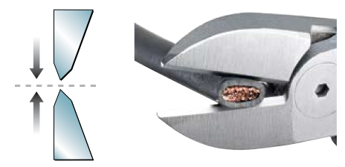
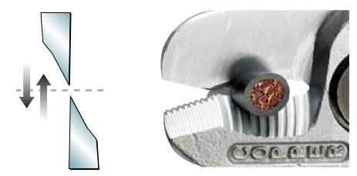
Cutting the wire correctly matters
How to apply a lug
Be sure to not damage the wire when cutting.
Incorrect cut: Bite cut, squeezing the wire
Correct cut: Shear cut

Slide 4
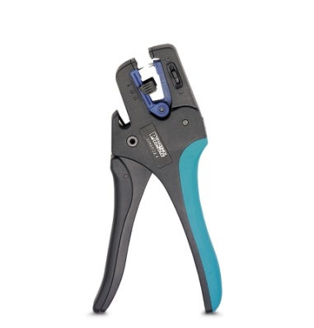
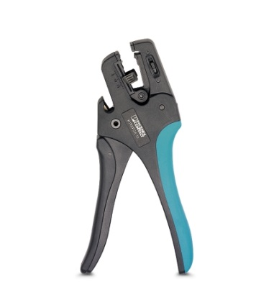
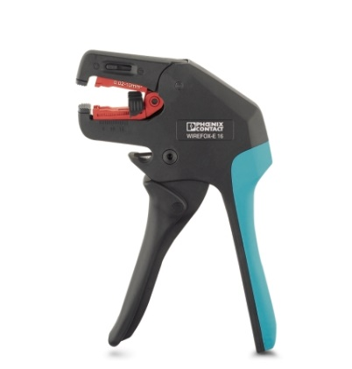
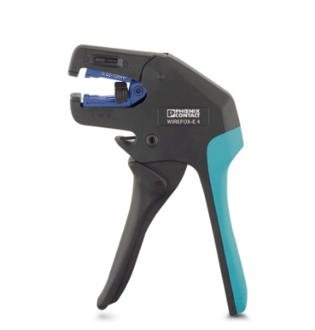
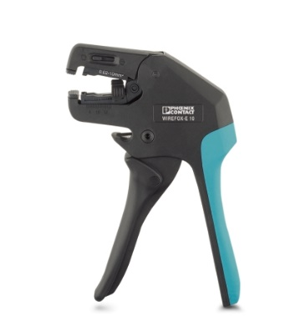
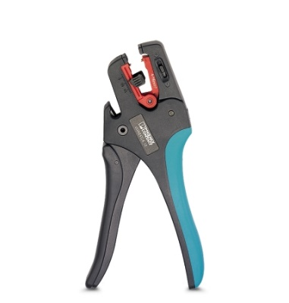
Choosing the correct wire stripping tool matters
How to apply a lug
V-blade
Flat blade
Oval blade
WIREFOX – 4 1212159
WIREFOX-E 4 1212704
28-12 AWG
WIREFOX – 6SC 1212158
WIREFOX-E 6SC 1212705
16-8 AWG
WIREFOX – 10 1212150
WIREFOX-E 10 1212706
34-8 AWG
WIREFOX – 16 1212155
WIREFOX-E 16 1212707
12-5 AWG

Slide 5
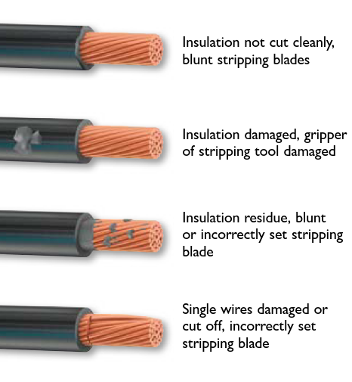
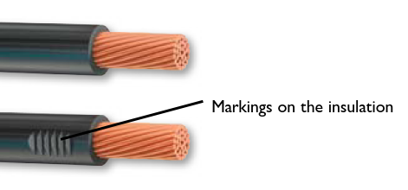
Stripping the wire correctly matters
How to apply a lug
Be sure to not damage the strands or insulation when stripping the wire.
Incorrect strip:
Correct strip:

Slide 6
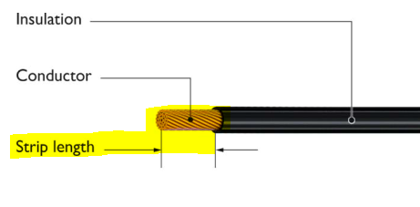
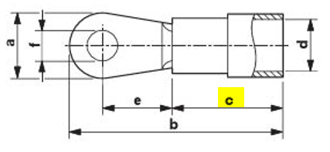
Stripping the wire correctly matters
How to apply a lug
Strip length equals the barrel of the lug (c)
Once the wire is stripped, insert it into the lug starting from the insulated or barrel side (d)
The strands should completely fill the barrel and protrude no more than .02” (0.5mm)
d

Slide 7
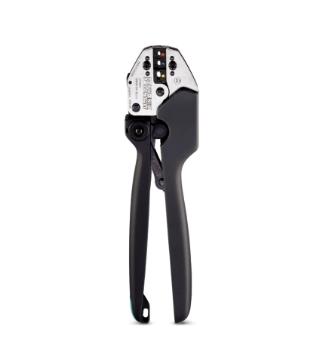
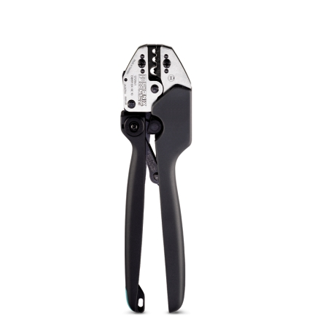
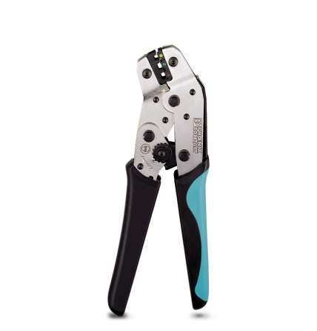
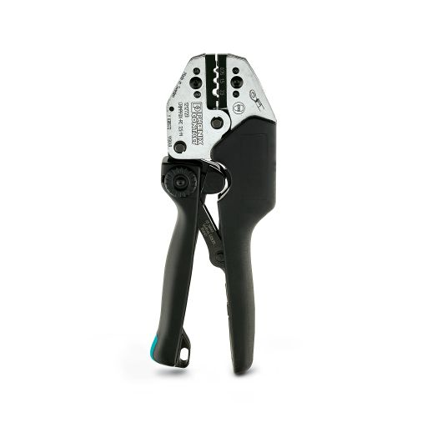
Choosing the correct crimping tool matters
How to apply a lug
Insulated lugs use the Crimpfox RCI series
Uninsulated lugs use the Crimpfox RC series
Crimpers vary by AWG range and length of the handle
CRIMPFOX-RCI 1 1212055 26-18 AWG
CRIMPFOX-RCI 2,5 1212053 20-14 AWG
CRIMPFOX-RCI 6 1212057 20-10 AWG
CRIMPFOX-RC 2,5 1212063 22-14 AWG
CRIMPFOX-RC 6 1212710 20-10 AWG
CRIMPFOX-RC 10 1212061 12-8 AWG

Slide 8
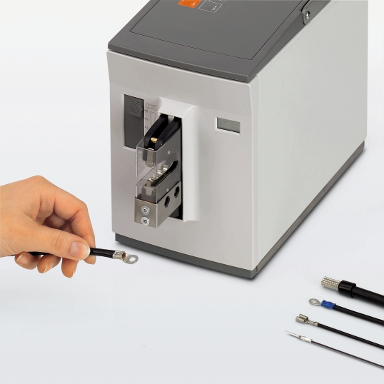
Or automate the crimping
How to apply a lug
CF 500 1208351 Machine – no dies included
CF 500/DIE RCI 1,5 1212263 24-16 AWG
CF 500/DIE RCI 6 1212240 20-10 AWG
CF 500/DIE RC 10 1212244 20-8 AWG
CF 500/DIE RC 16 1212257 6 AWG
CF 500/COV RCI 1212255 Protective cover for insulated lugs
CF 500/COV RC 10 1212252 Protective cover for uninsulated lugs

Slide 9
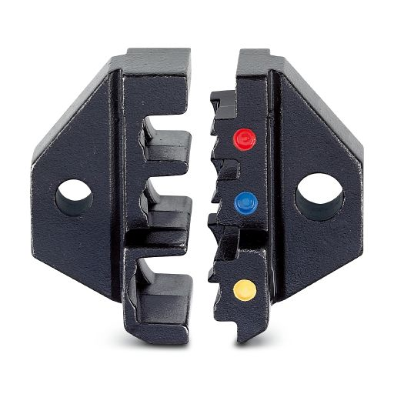
Crimping in the correct nest matters
How to apply a lug
Red lugs = 22 – 16 AWG
Blue lugs = 16 – 14 AWG
Yellow lugs = 12 – 10 AWG

Slide 10
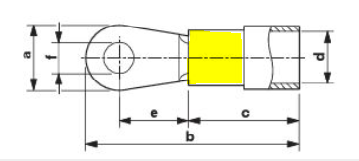
Crimping the lug correctly matters
How to apply a lug
Only crimp the highlighted area of the insulation
Be sure the ring or fork section of the lug is horizontal to the die otherwise they could be deformed in the crimping process

